Slide 1
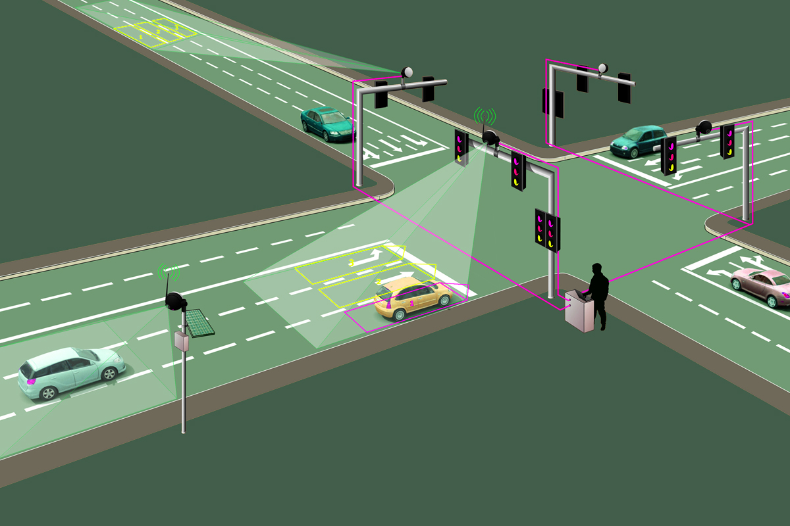
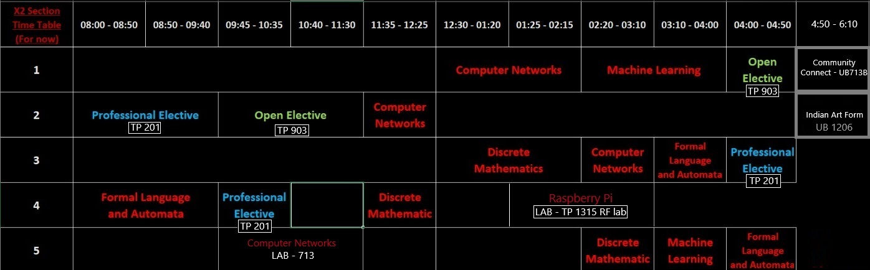
AI BASED TRAFFIC MANAGEMENT SYSTEM FOR SMART CITIES
Presented By:
GEETANSH RAJESH (RA2211026010338)
SHYAM KUMAR SHAH (RA2211026010371)
ANJALI SATIJA
(RA2211026010390)
KUSHAGRA PUROHIT (RA2211026010391)
COURSE : 21CSC305P MACHINE LEARNING
Date: 7 August 2024

Slide 2
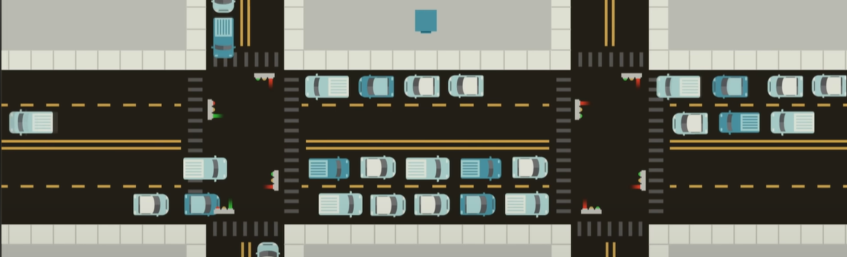
PROBLEM STATEMENT
Issues such as Urban traffic congestion, Traffic weight time and wastage of fuel, Driver frustration issues are some of the most pressing issues pressing issue leading to significant economic losses, Environmental pollution, and decreased quality of life..

Slide 3
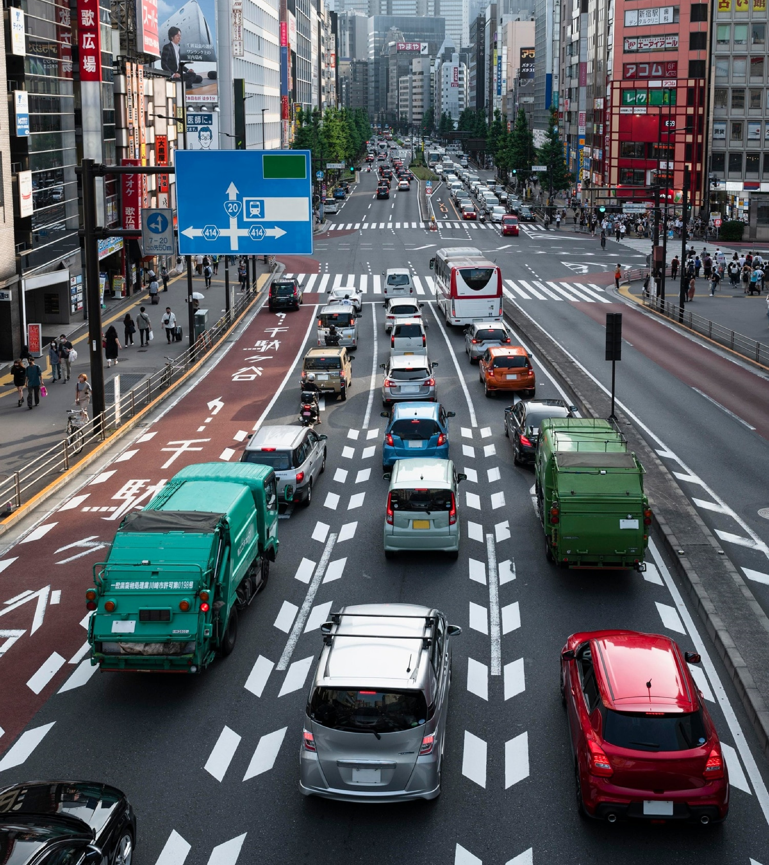
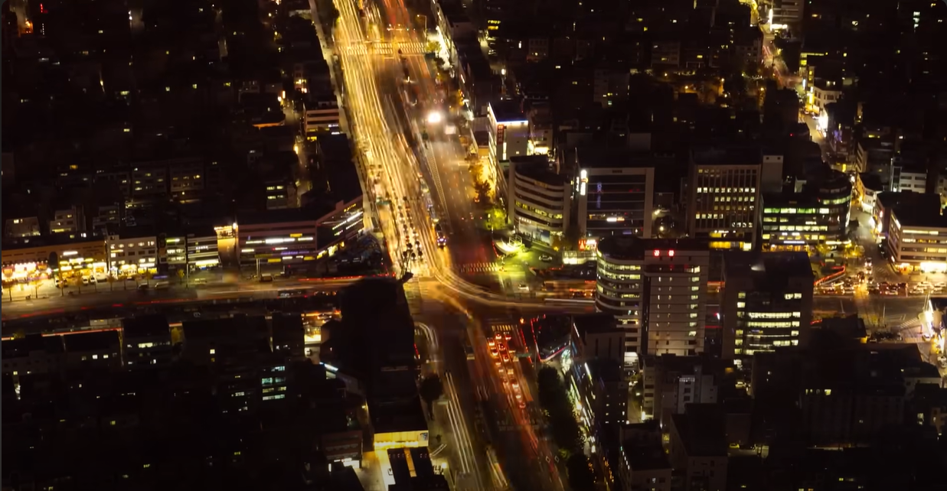
OBJECTIVE
To design, develop, and deploy an advanced AI-based traffic management system for smart cities. This system will leverage real-time data from various sources to predict & optimize traffic patterns.

Slide 4
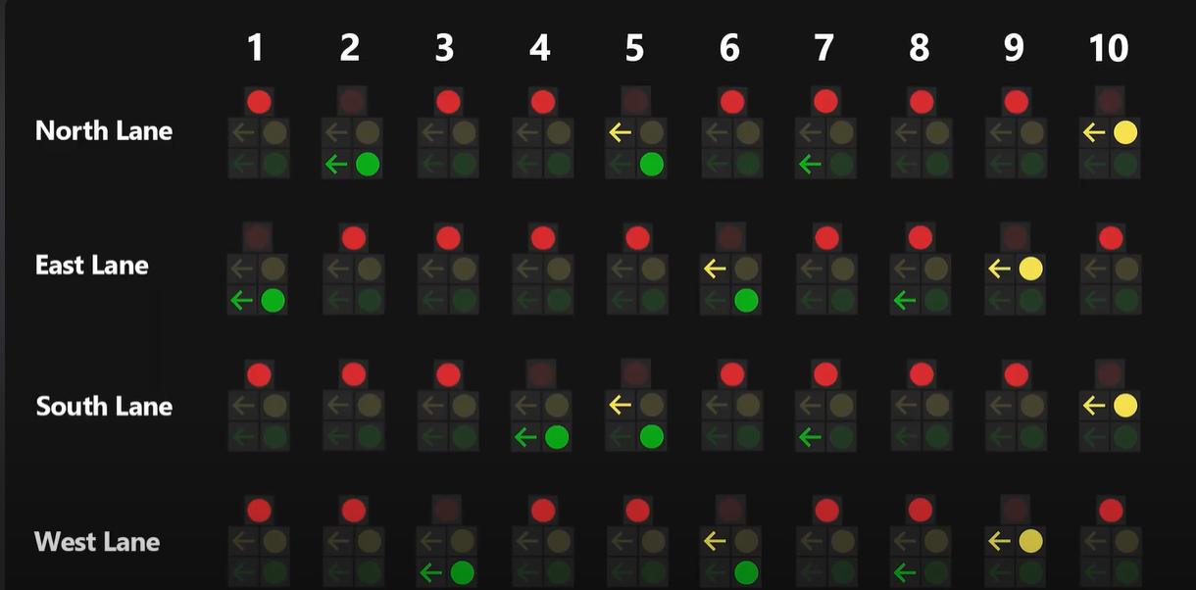
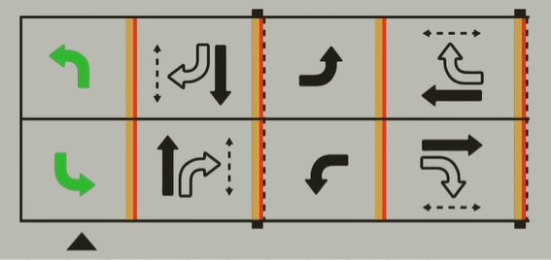
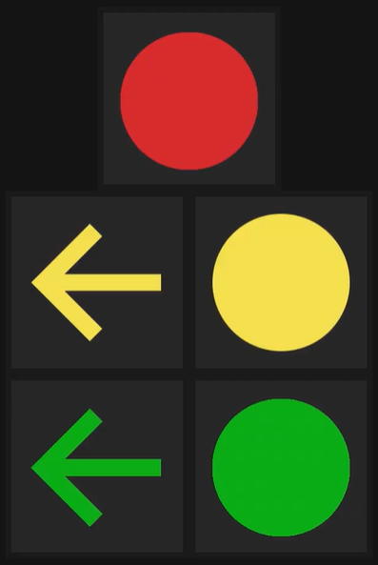
IMPLEMENTATION METHODS
Implementing an AI traffic signal prediction system using a feedback neural network (RNN/LSTM) with Python NEAT and a GUI using Py-Game, along with a database of various types of vehicles and their speeds, is a complex project. Here’s a structured approach to tackle this project, including the main components and implementation methods:
The Database is extracted from OpenML.
The py-game simulation is generating vehicles using the database formed.
The activation function used is ReLU.
The 8 lanes are managed through traffic signals.
The RNN has its feedback score formed by using a Road Rage value that’s formed as by adding a linear value per unit time a vehicle is waiting in any lane.
Feedback : SCORE = 1/(ROAD RAGE)
(Types of Lane Diversions)
(Traffic Signal’s)

Slide 5
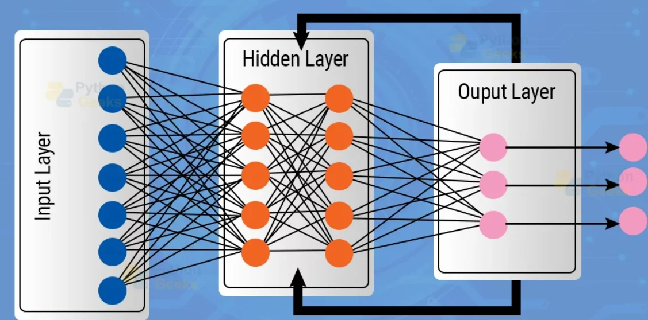
Recurrent Neural Net Model
Implemented by (PY-NEAT)
Recurrent Neural Networks (RNNs) are a class of neural networks designed to handle sequential data by maintaining a memory of previous inputs through internal states. Traditional RNNs often use activation functions like the hyperbolic tangent (tanh) or sigmoid functions. However, using Rectified Linear Unit (ReLU) as an activation function in RNNs can be beneficial in certain scenarios.
Model Layer Specifications:
16: INPUT LAYERS
12: HIDDEN LAYER 1
10: HIDDEN LAYER 2
9: HIDDEN LAYER 3
8: HIDDEN LAYER 3
10: FINAL MAX POOLING LAYER
8:OUTPUT LAYER
(Model Activation/Working Function)
ReLU (Rectified Linear Unit)
ReLU(x) = max(0,x)
Pros: Computationally efficient, mitigates the vanishing gradient problem, Sparse activations reduce the amount of computation needed during forward and backward passes, potentially speeding up training and inference.

Slide 6
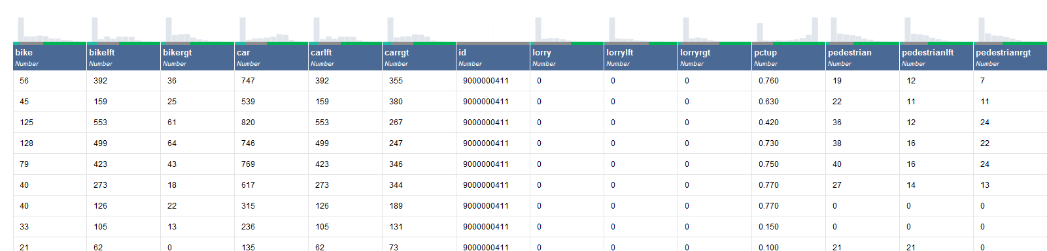
DATABASE OVERVIEW
Description :
This dataset, extracted from OpenML, contains traffic data collected using cameras. It comprises 1000 rows and 25 columns, detailing various traffic parameters over time. The dataset is intended for time series forecasting to predict traffic flow. Below is a detailed description of the dataset's structure and the significance of each attribute.
Structure -
Total Rows: 1000+
Total Columns: 25

Slide 7
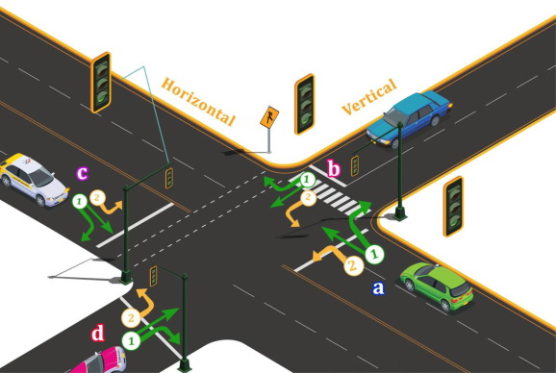
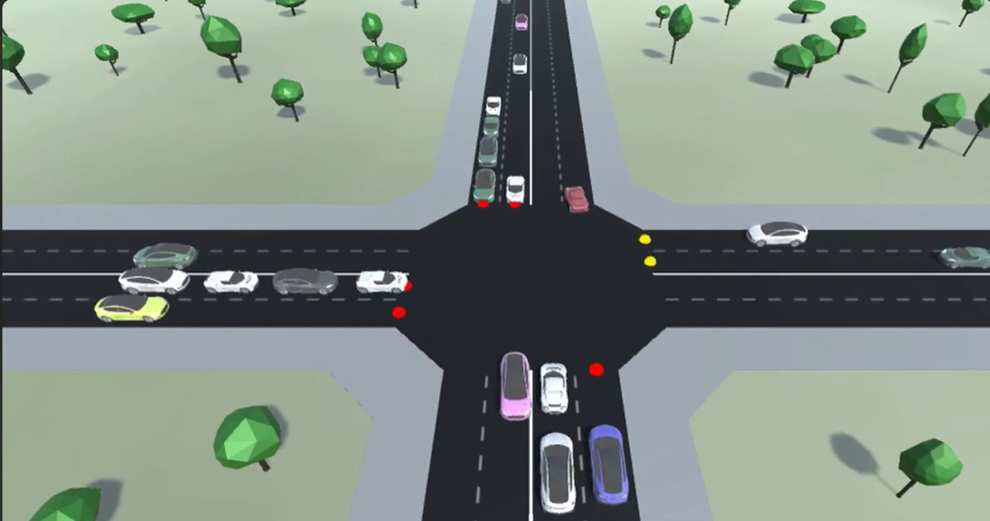
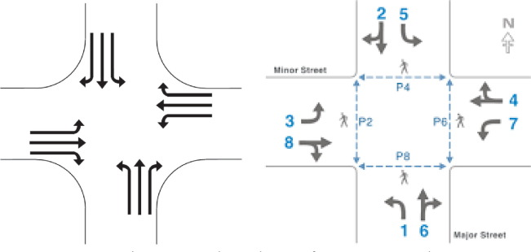
SIMULATION
(PyGame)

Slide 8
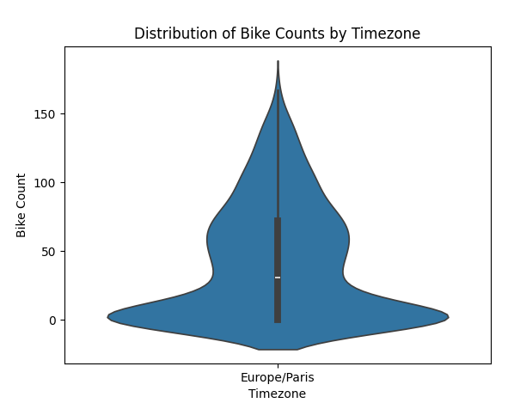
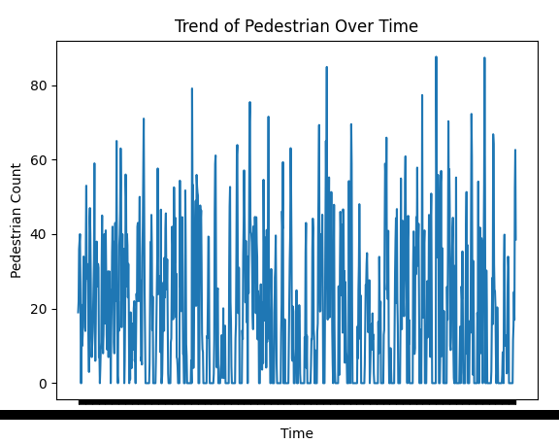
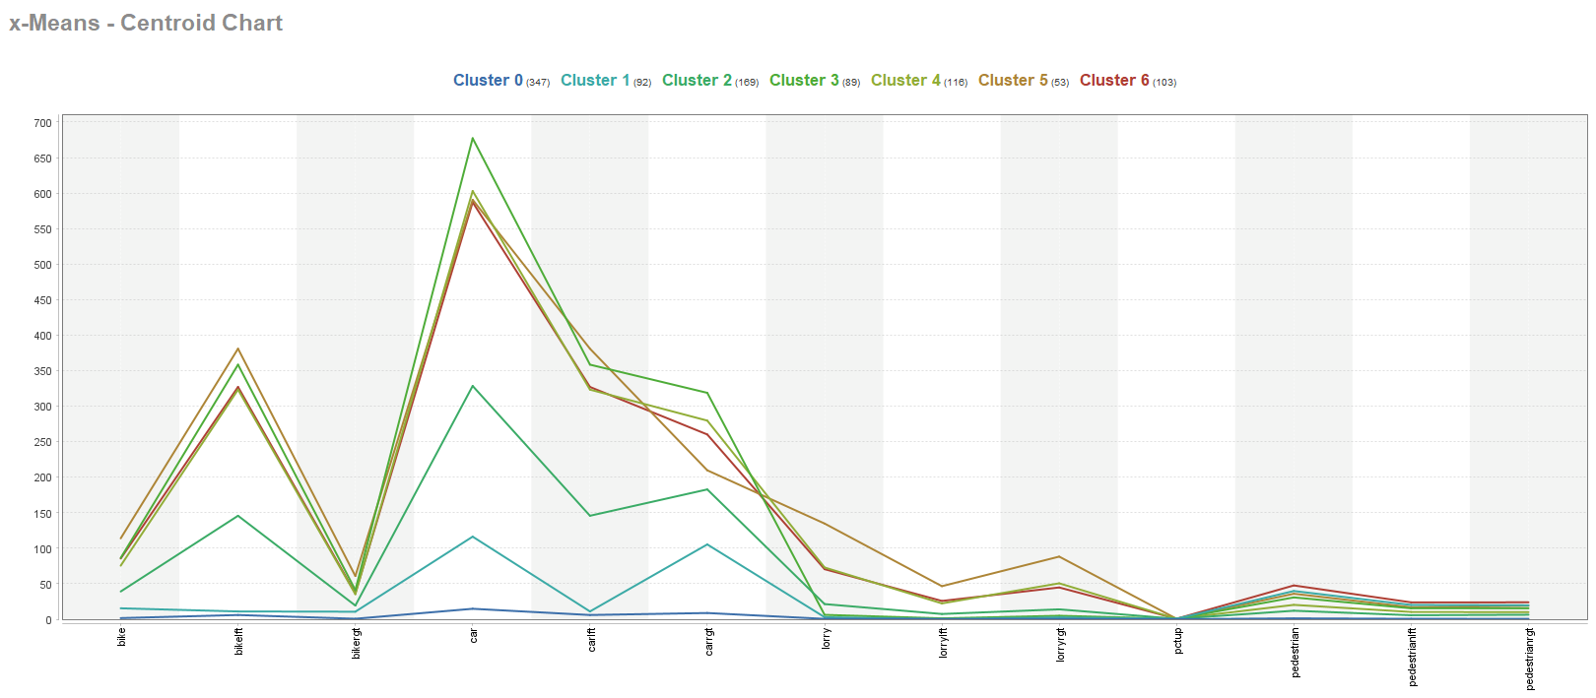
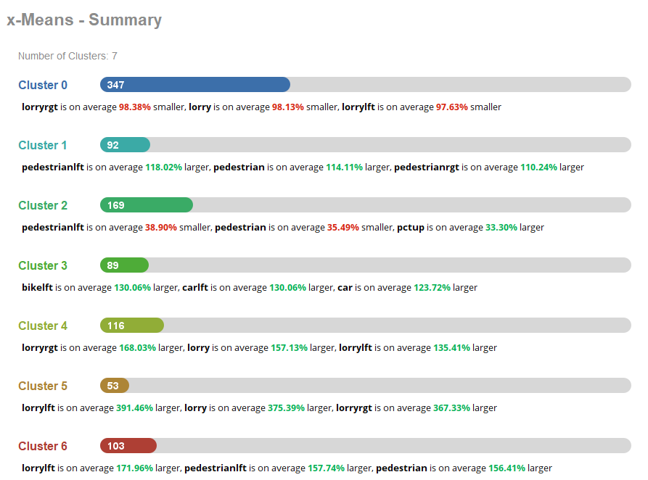
DATASET Statistical Analysis
Mean Values:
id 9.000000e+09
pctup 4.517825e-01
pedestrian 1.856460e+01
bike 4.113197e+01
car 3.027007e+02
lorry 2.834085e+01
pedestrianlft 9.219905e+00
bikelft 1.558054e+02
carlft 1.558054e+02
lorrylft 9.469943e+00
pedestrianrgt 9.344693e+00
bikergt 1.980722e+01
carrgt 1.468954e+02
lorryrgt 1.887090e+01
dtype: float64
Variance Values:
id 0.000000
pctup 0.106895
pedestrian 357.689777
bike 1799.385148
car 78070.534813
lorry 1653.930566
pedestrianlft 96.747332
bikelft 27082.752570
carlft 27082.752570
lorrylft 236.727140
pedestrianrgt 99.640260
bikergt 420.015481
carrgt 18509.506643
lorryrgt 754.069649
dtype: float64
Median Values:
id 9.000000e+09
pctup 6.300000e-01
pedestrian 1.400000e+01
bike 3.095327e+01
car 2.832962e+02
lorry 0.000000e+00
pedestrianlft 7.000000e+00
bikelft 1.160000e+02
carlft 1.160000e+02
lorrylft 0.000000e+00
pedestrianrgt 6.844106e+00
bikergt 1.496599e+01
carrgt 1.297674e+02
lorryrgt 0.000000e+00
dtype: float64

Slide 9
METHODOLOGY
1
2
3
4
5
Data Collection & Preprocessing:
Extract and preprocess vehicle and traffic data from OpenML for simulation and prediction.
Model Design and Implementation:
Create an RNN with ReLU activation for traffic prediction and feedback-based signal optimization.
Deployment and Integration:
Develop a PyGame GUI for simulation and deploy the system for real-time traffic management.
Traffic Signal Optimization:
Manage 8 traffic signals using NEAT RNN model to minimize congestion and road rage.
Evaluation and Testing:
Measure system performance on congestion reduction, air quality improvement, and prediction accuracy.

Slide 10
THANK YOU

